Slide 1
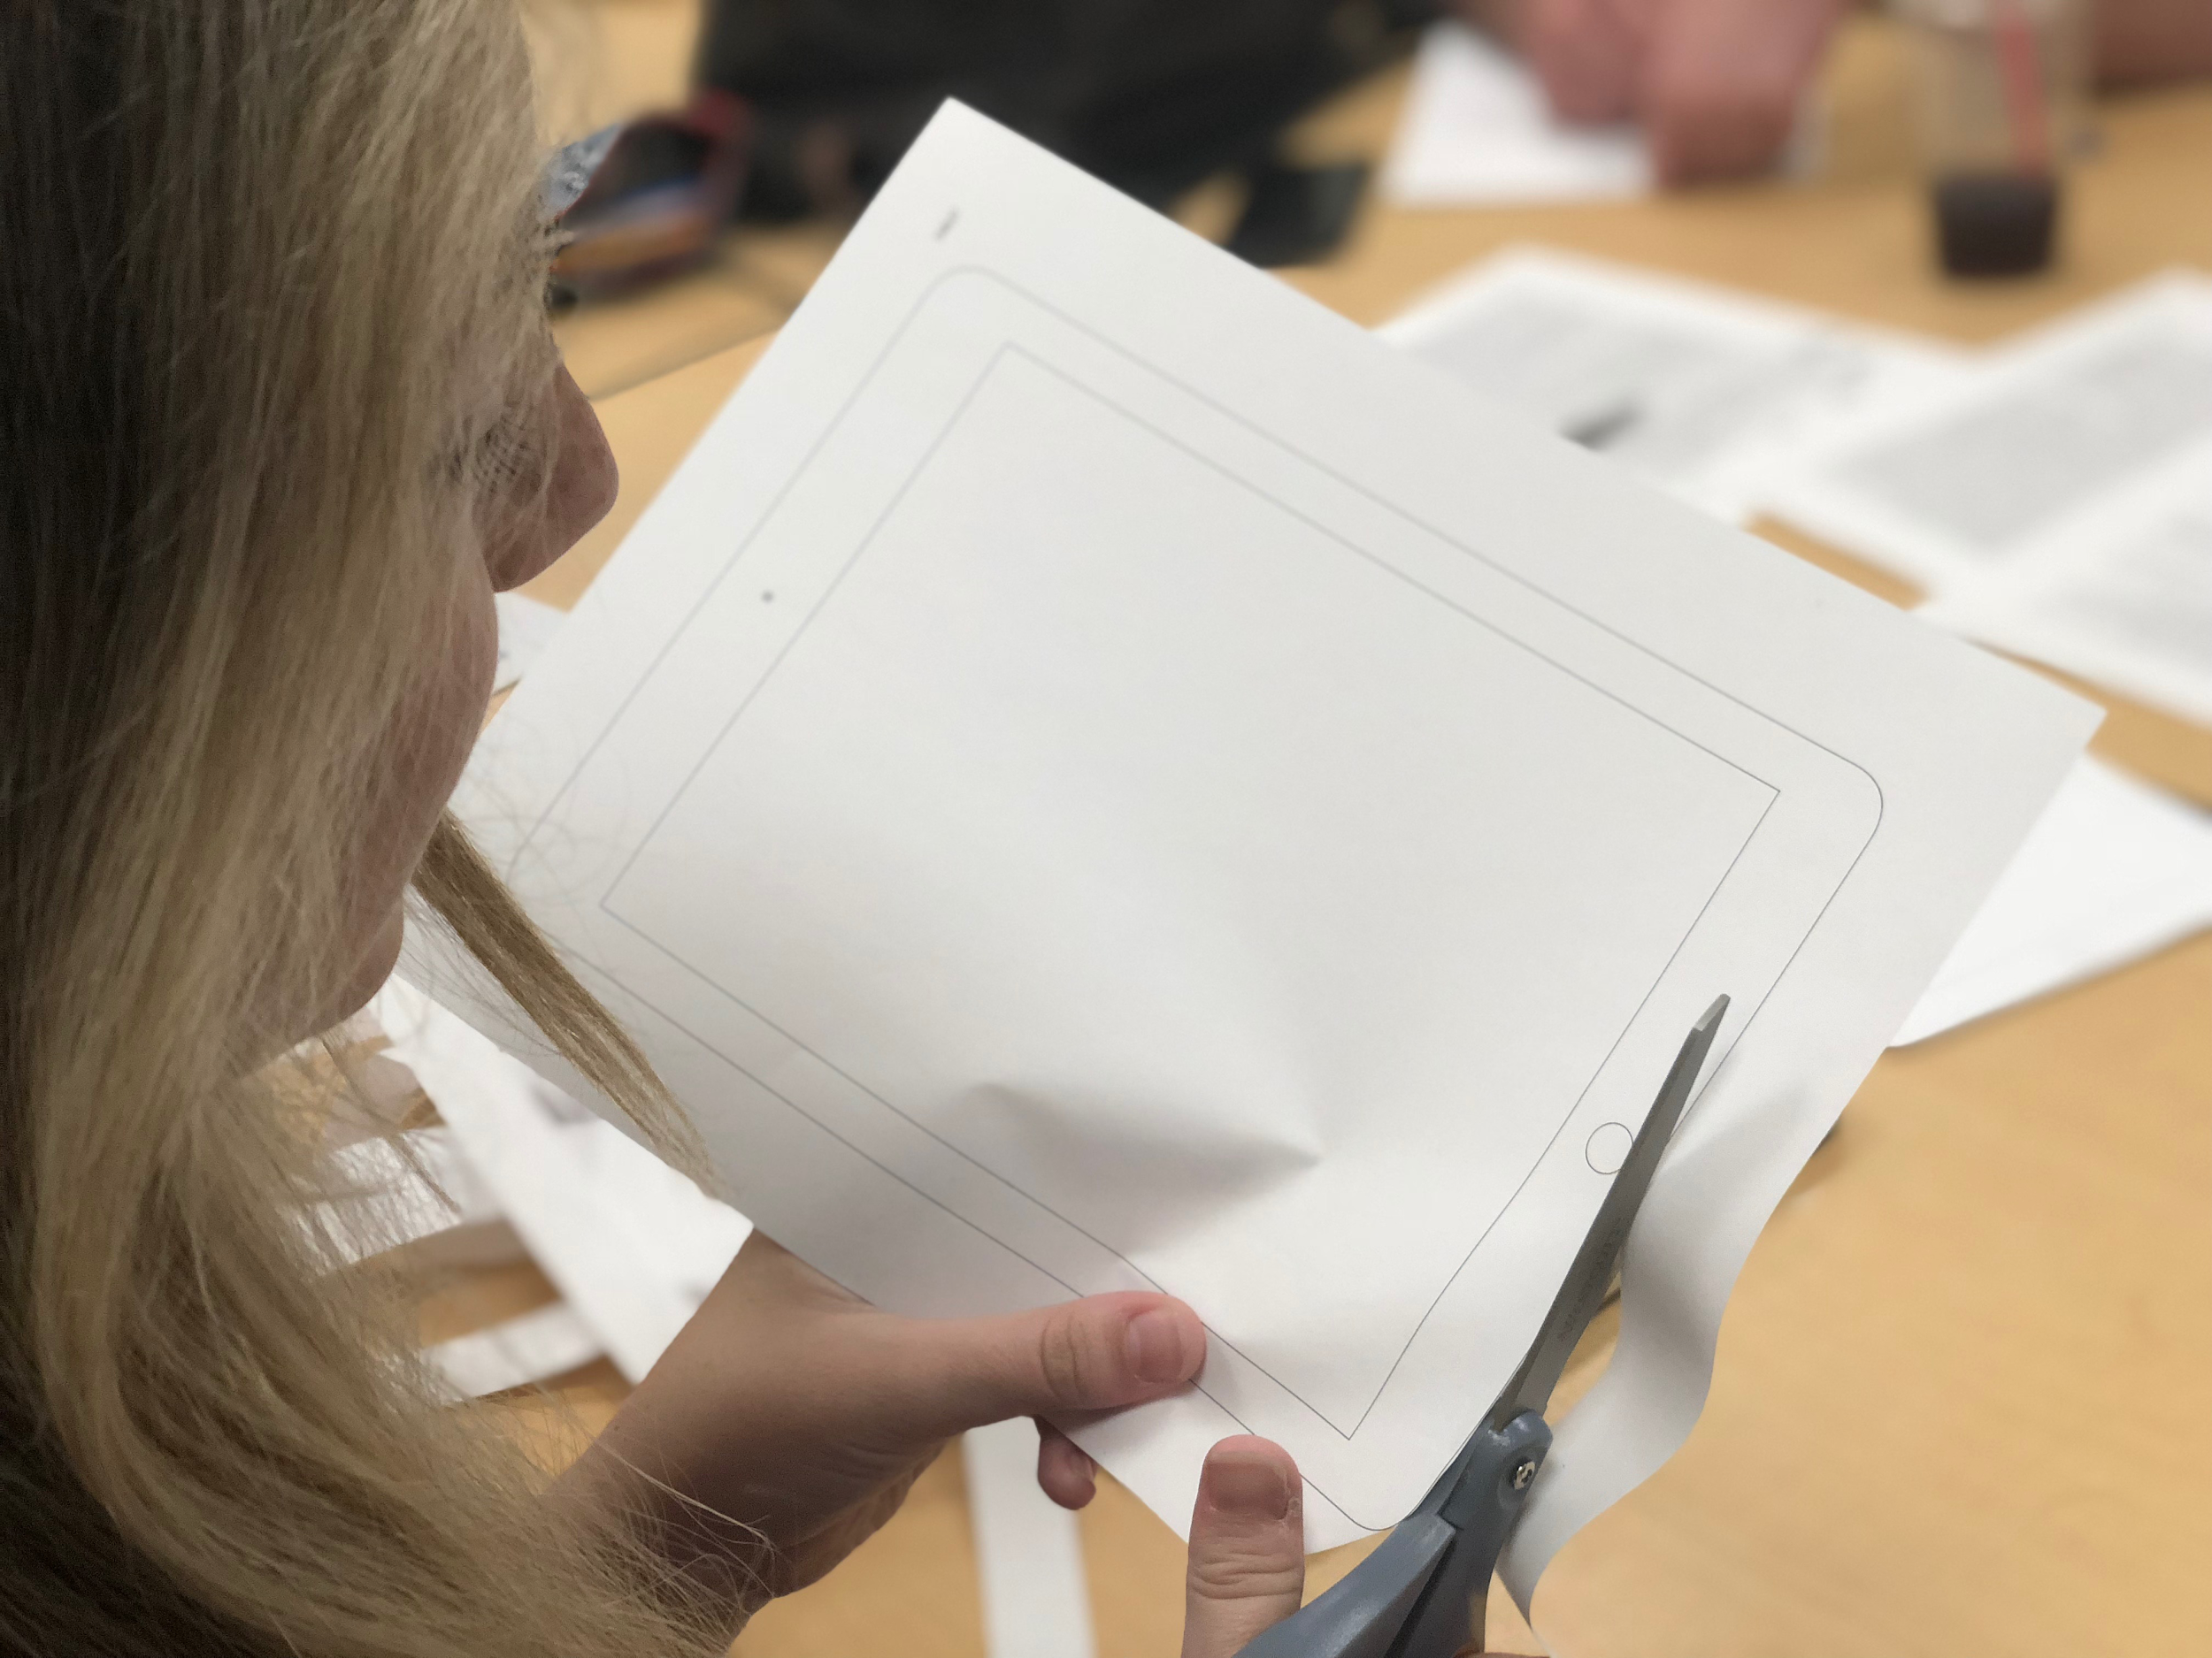
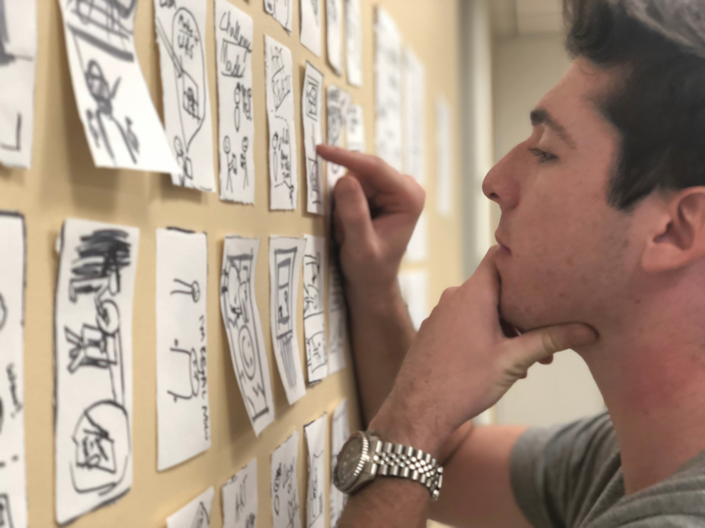
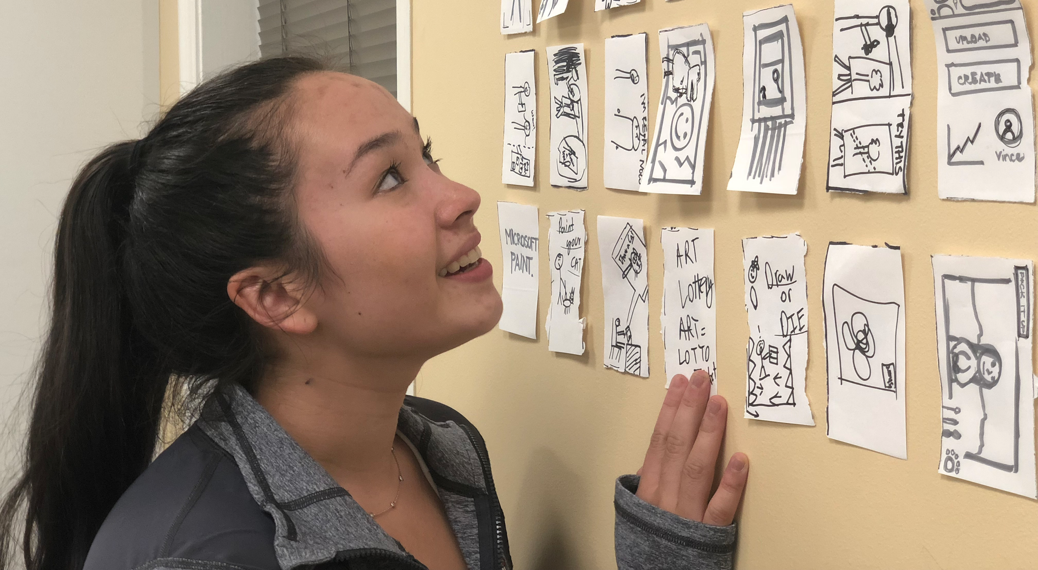
Artbot
Lo-Fi Prototype
–
Team Articulate

Slide 2
Artbot
Mission Statement
Selected Interface
Low-fi Prototype
3 Task Flows
Experiment
Method
Results
UI Changes and Summary

Slide 3
Artbot Antagonistic, artful companion
We set out to tackle the dreaded problem artists of all levels face during the creation process – the block.
The block is when artists become too attached to their work but are unable to see a path forward in their work that satisfies them.
Artbot attempts to free artists from this mode of thinking using a gameified approach coupled with long-term check-ins.

Slide 4
Mission Statement:
Artbot is designed to boost your creative adaptability.

Slide 5
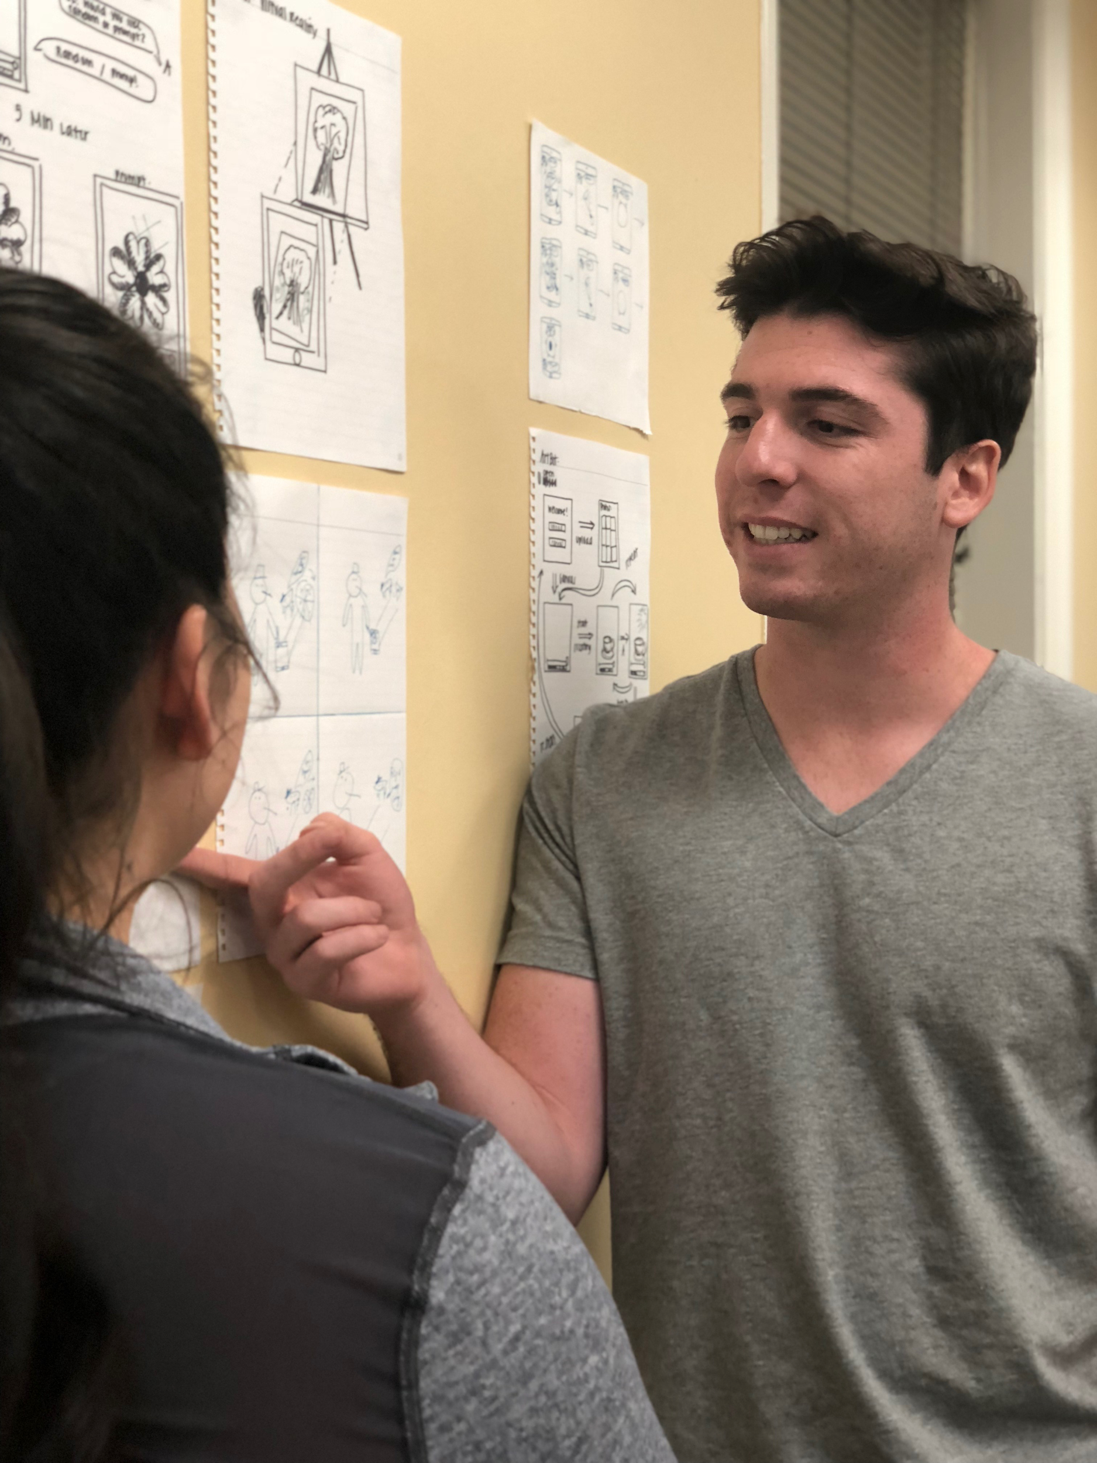
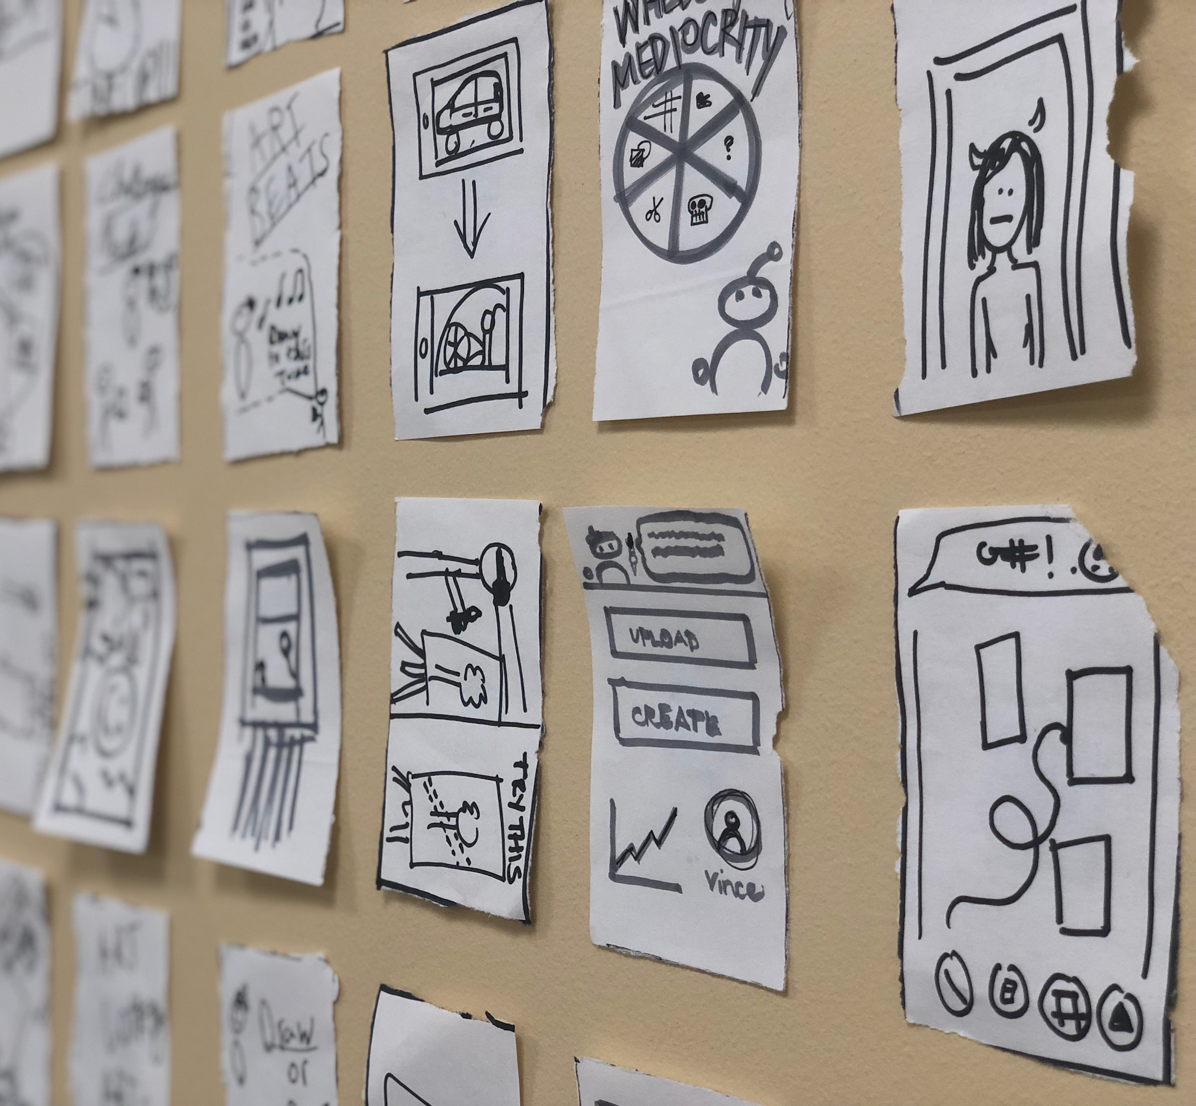
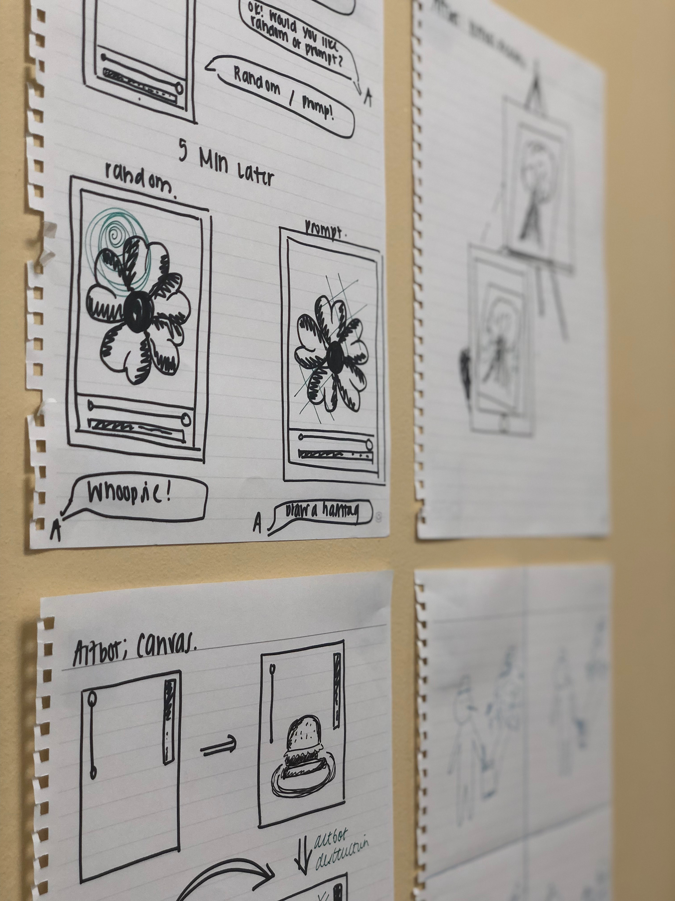
Selected Interface

Slide 6
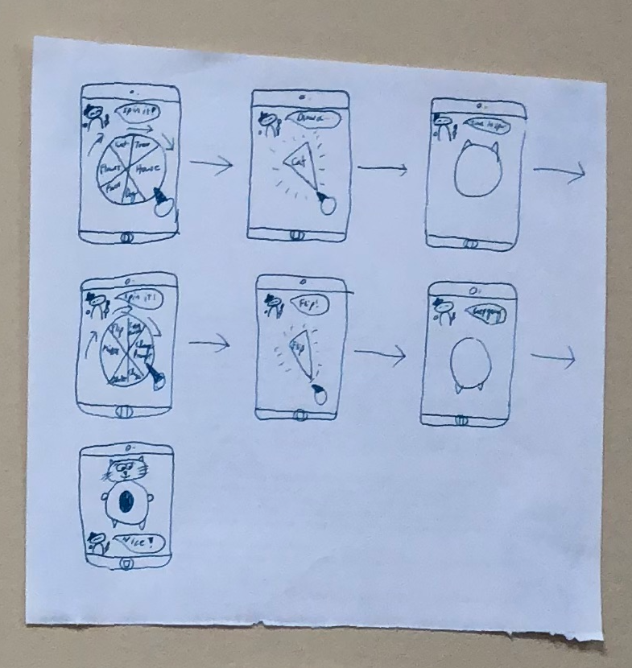
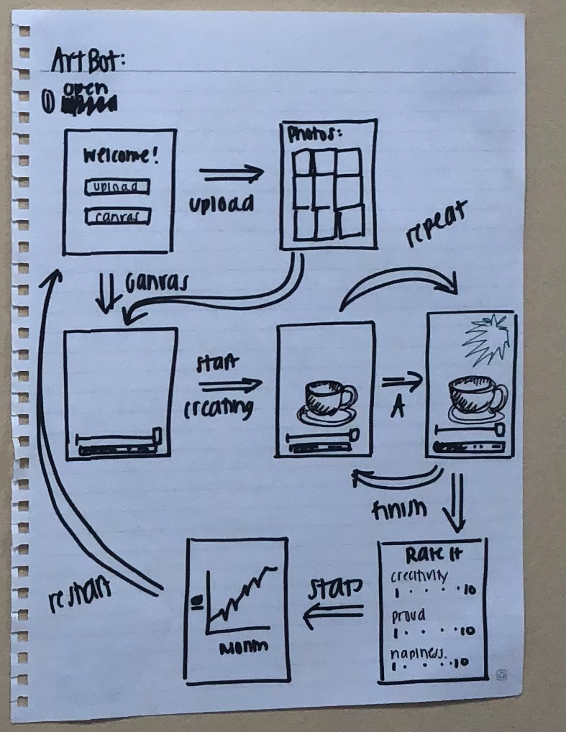
Artbot as a Canvas
Artbot as a
Wheel of Misfortune

Slide 7
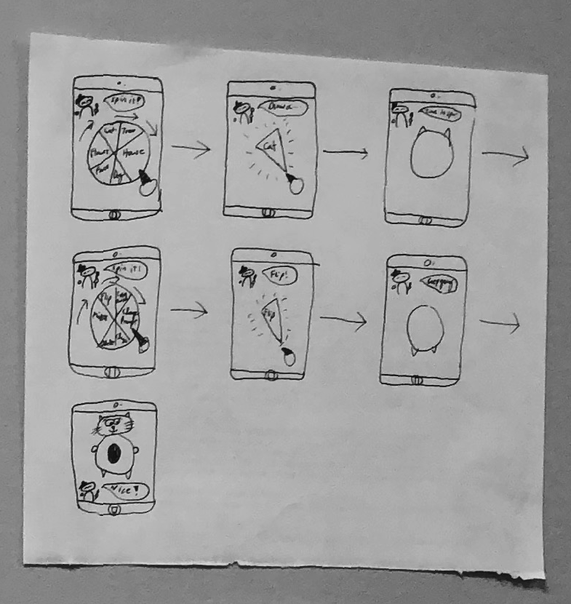
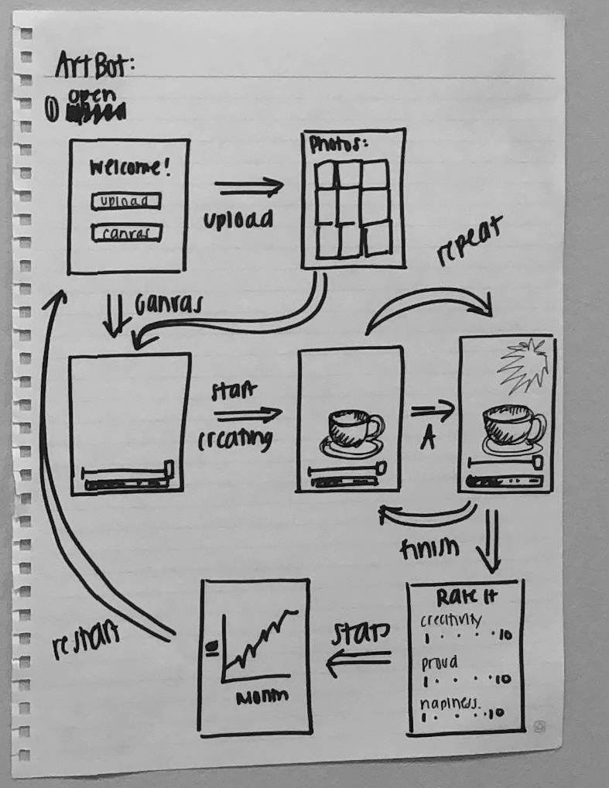
Artbot as a
Wheel of Misfortune
Pros
Controlled intervention
Greater gamification effect
Cons
More steps for the user
Less streamlined
Wheel will lose its novelty

Slide 8
Artbot as a
Canvas
Pros
Extension to long-term progress
Artbot has more personality
Cons
Limits art mediums
User has less control over intervention

Slide 9
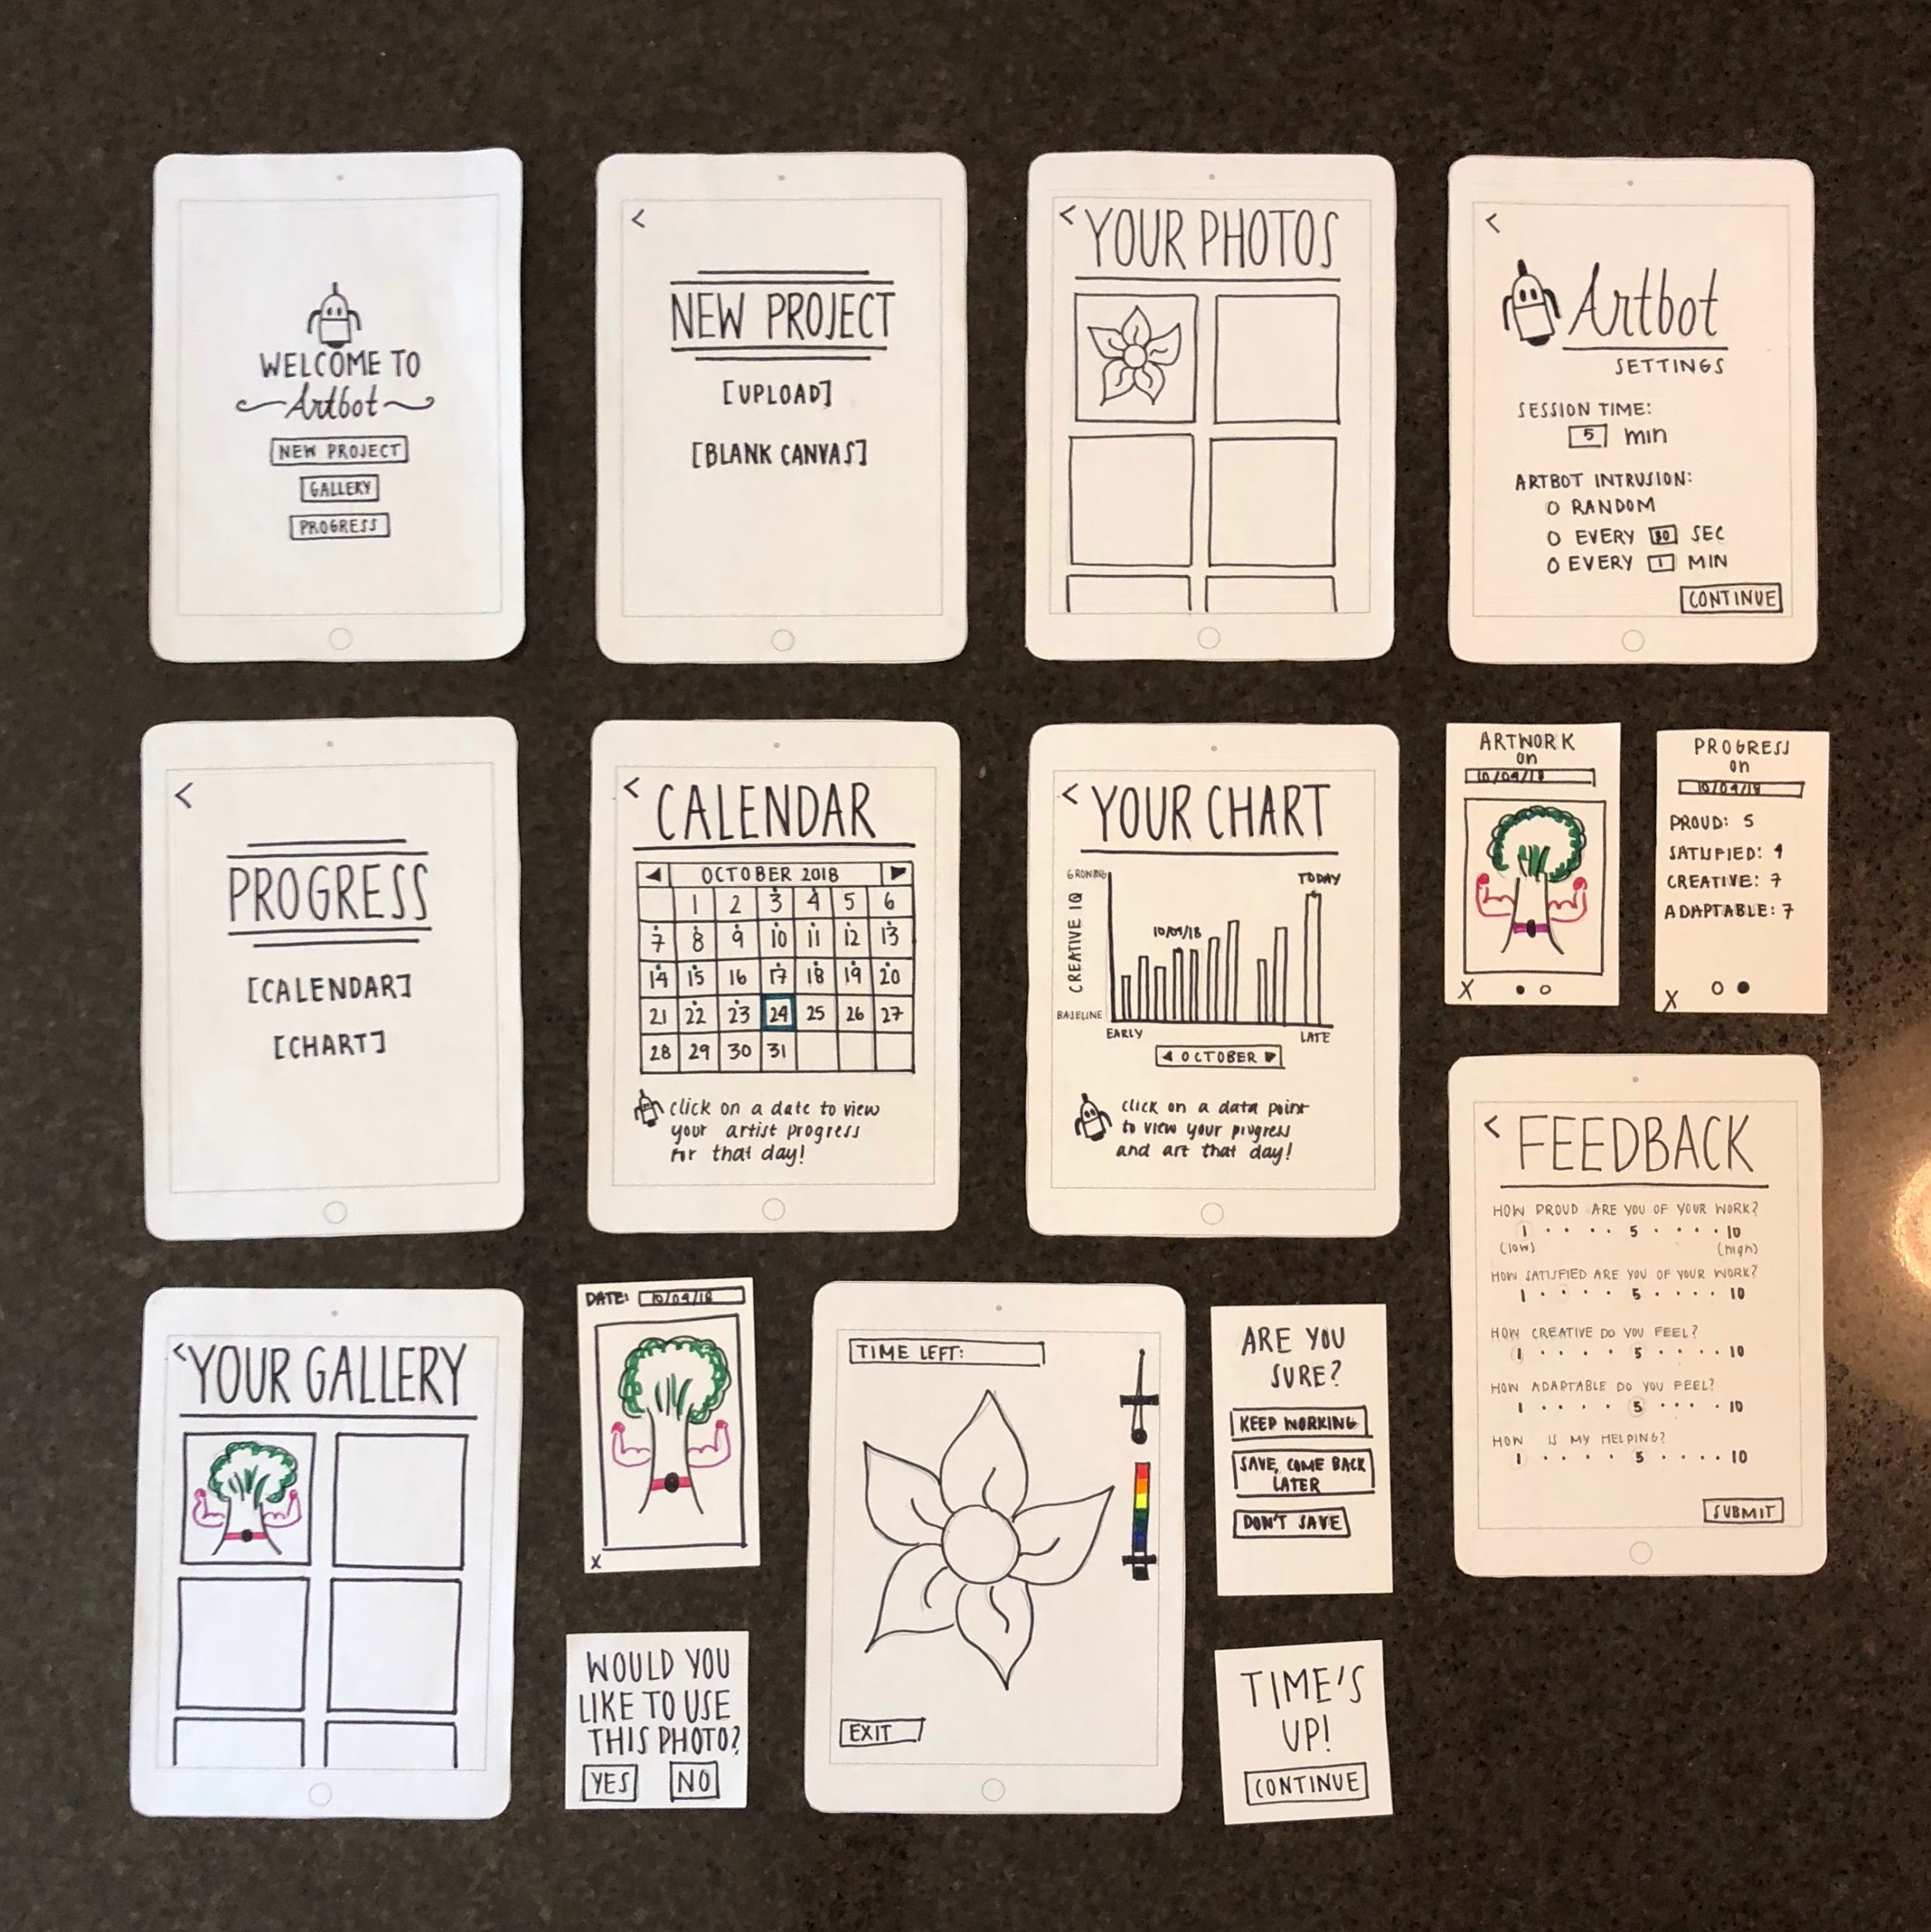
Low-fi Prototype
Paper prototype
iPad interface
Input involves minimal touch
Pens and supplies provided

Slide 10
Home Screen: A Preview
Task One
Task Two
Task Three
Home

Slide 11
Task One: Create a new project
Choose from your own photos
or a blank canvas

Slide 12
Task One: Create a new project
Pick your settings,
create,
and give feedback.

Slide 13
Task Two: Find previous disasterpieces
Find artwork you previously created.

Slide 14
Task Three: Check and monitor your Creative IQ
Monitor your disasterpiece and progress on any available date

Slide 15
Experiment -Participants
Berkeley Master’s Student
Public Health Sector Worker
Post-Doc in English

Slide 16
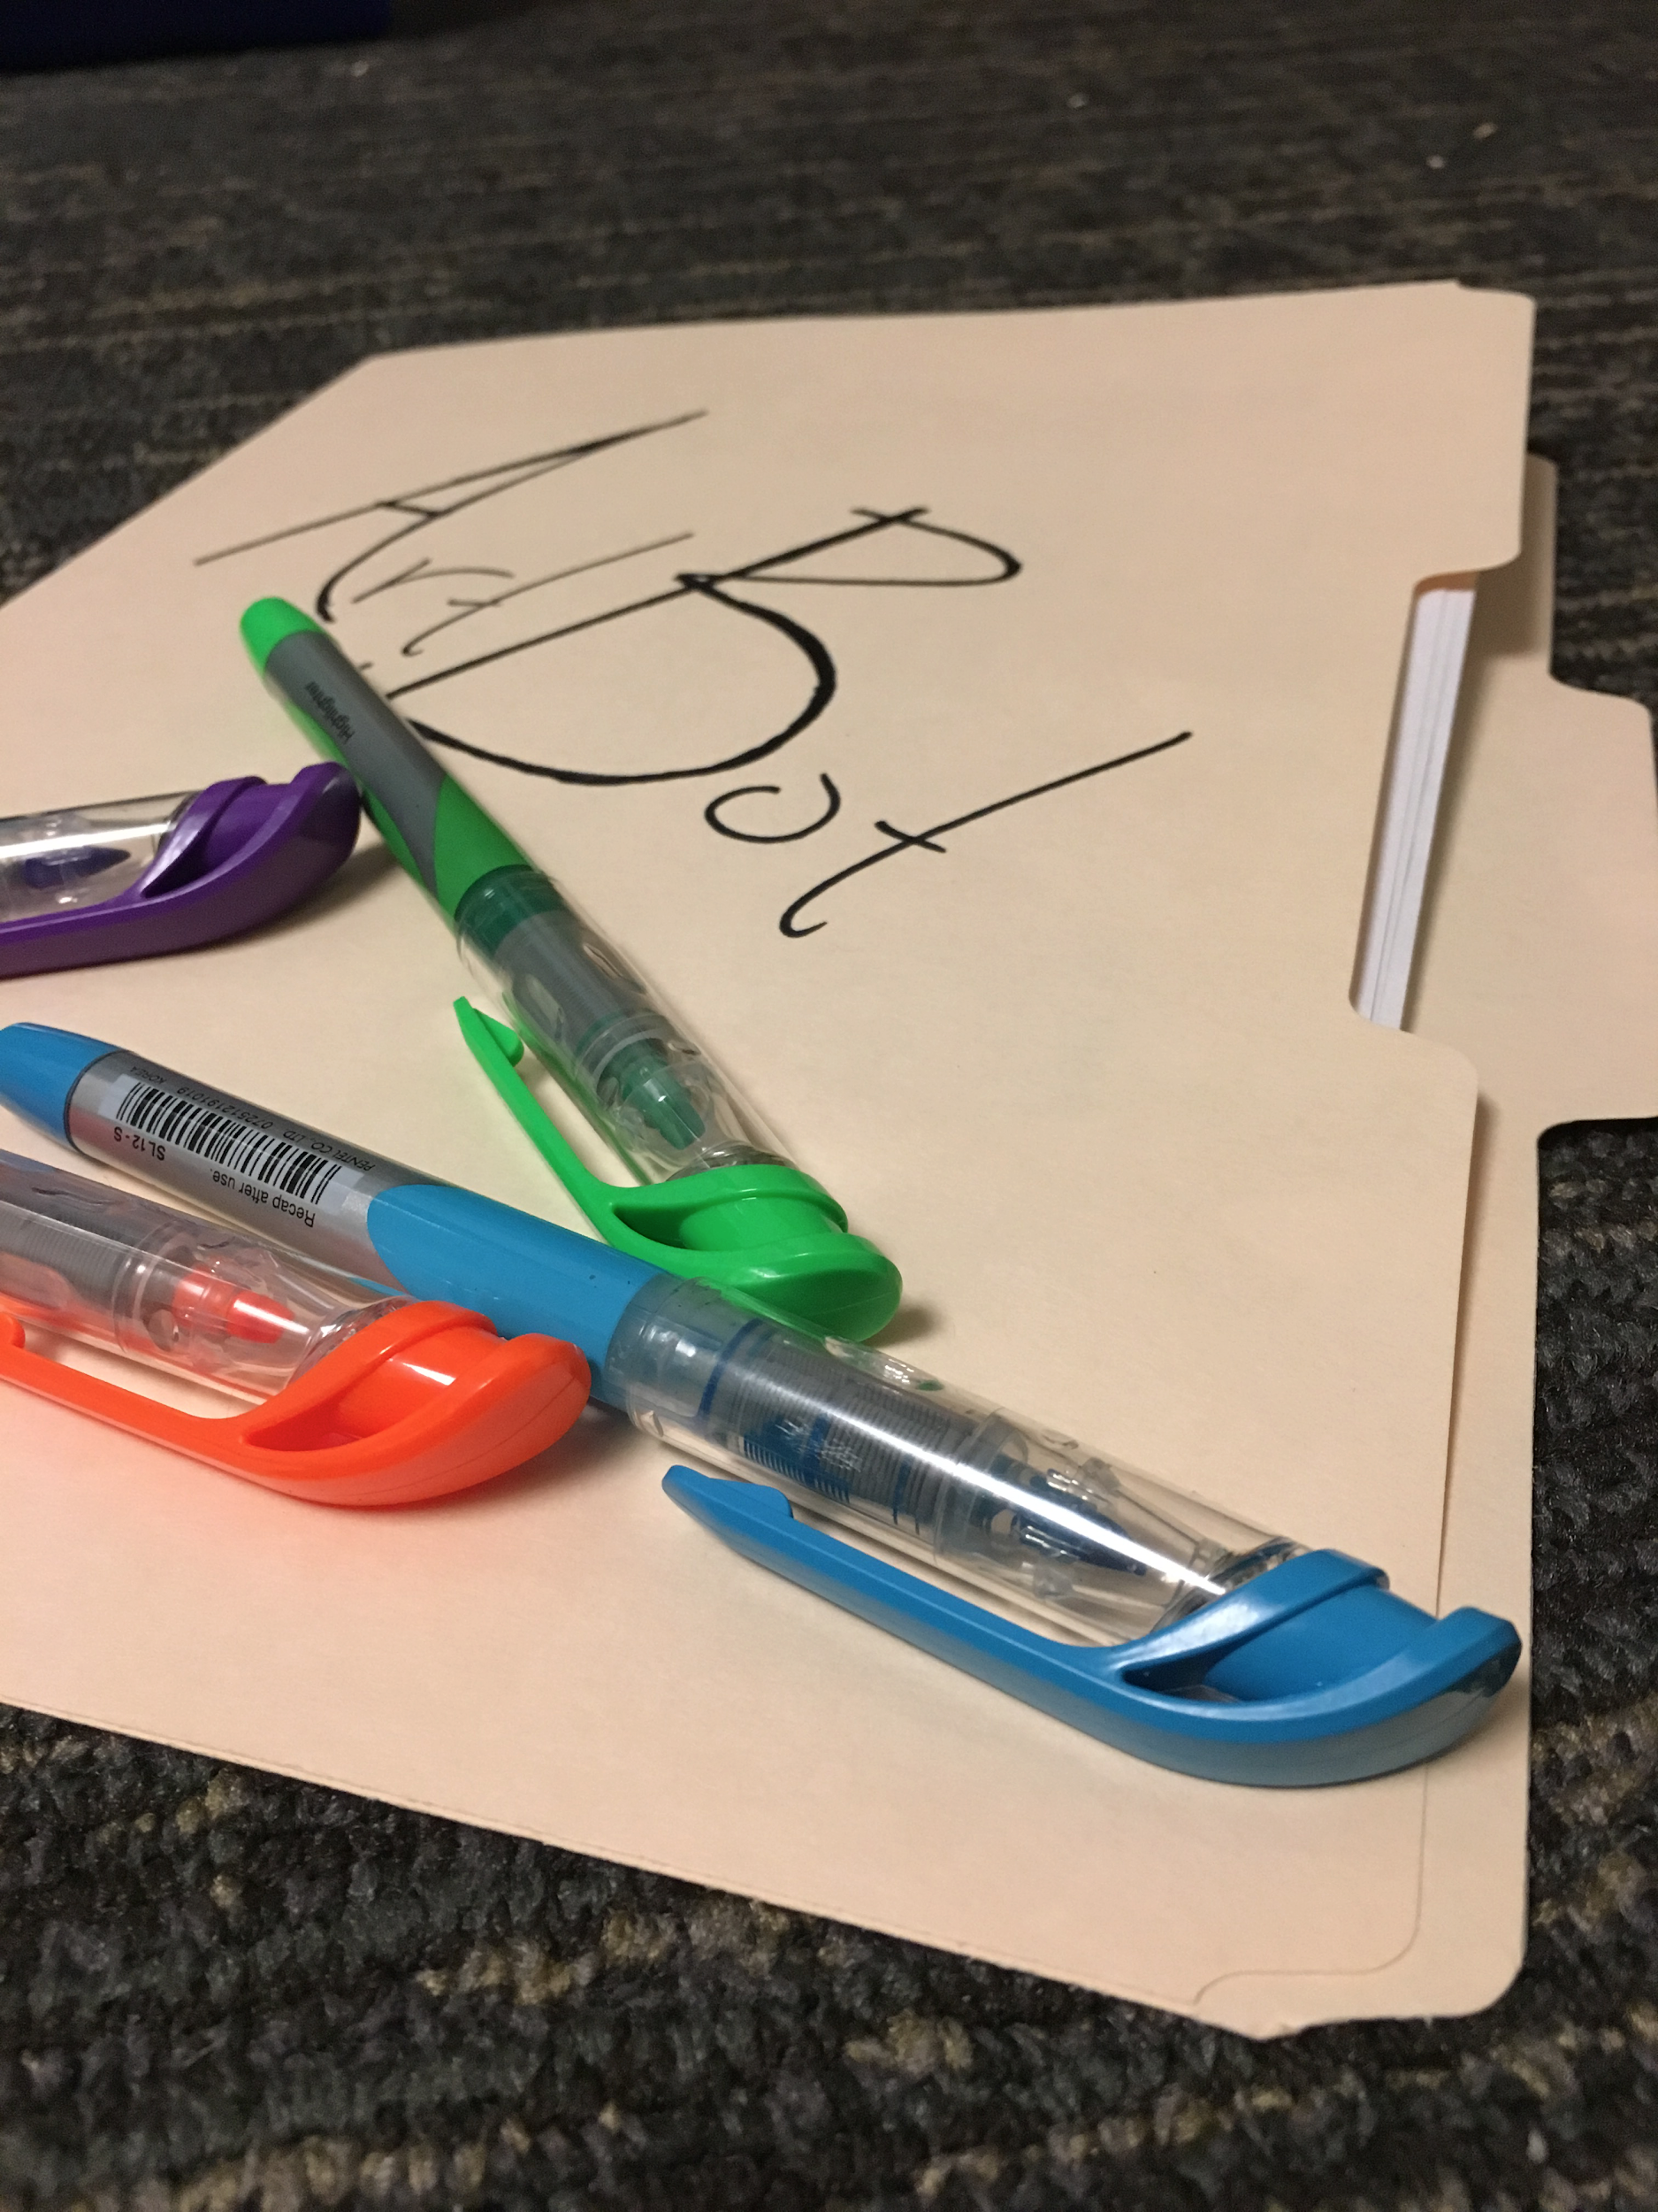
Environment
Minimal and quiet environment
All material in a folder and one space
Presented one screen at a time

Slide 17
Methodology
Used a script for consistency and to prompt our three tasks
Acted as the antagonistic artbot, drawing through their work
Kept track of timing, deviations, pain points, and successes
Debrief session at the end

Slide 18
Pain Points
“Creative Wellness” suggested a type of therapy rather than a creative boost
Our questions were more confusing than endearing and cheeky - especially “How was my helping?”
User wanted a way to navigate back to the homescreen
Users were confused with our swiping interfaces when navigating through old work.

Slide 19
Successes
Our participants had a lot of fun! They were curious and interested in what Artbot would do next.
“It was a low-stakes fun activity for a few minutes.”
“A rewarding moment was when I thought, ‘Ah, I’ve got to do mirror symmetry!’”
They loved the organization and design of our prototype.

Slide 20
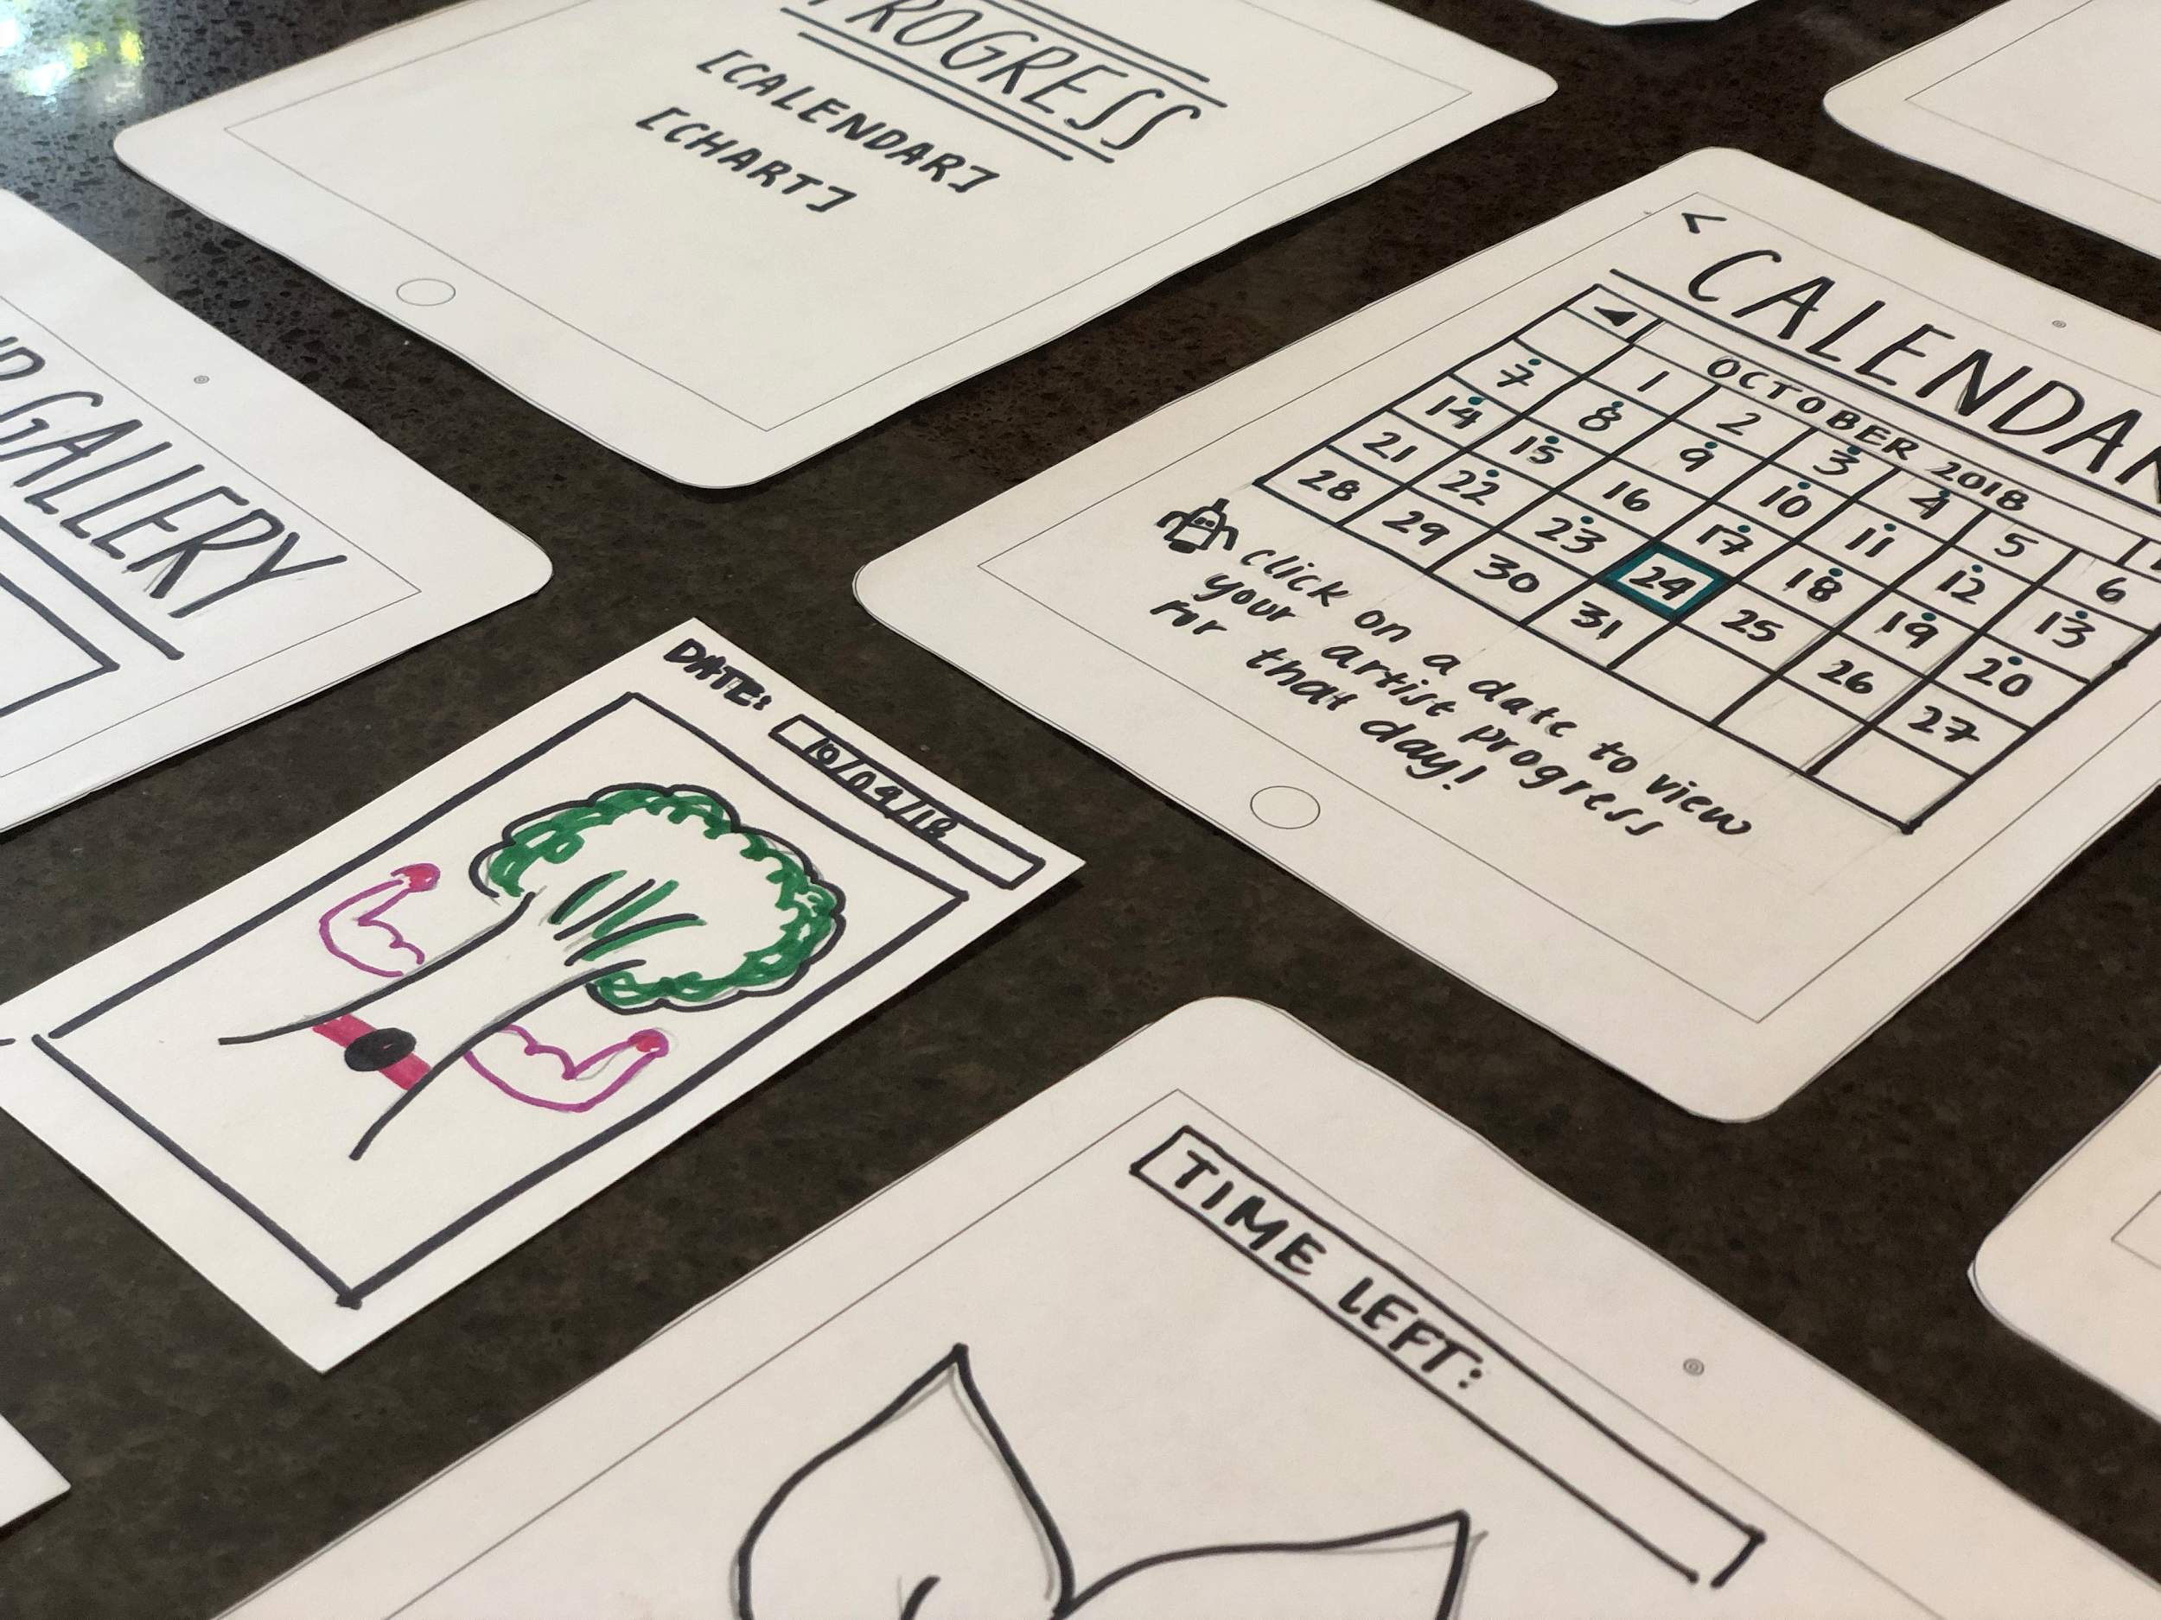
UI Changes
Clarify feedback questions - our questions should be straightforward
Need to improve navigation. through the application - perhaps with a navigation bar
When reviewing old work, utizlize scrolling instead of swiping.

Slide 21
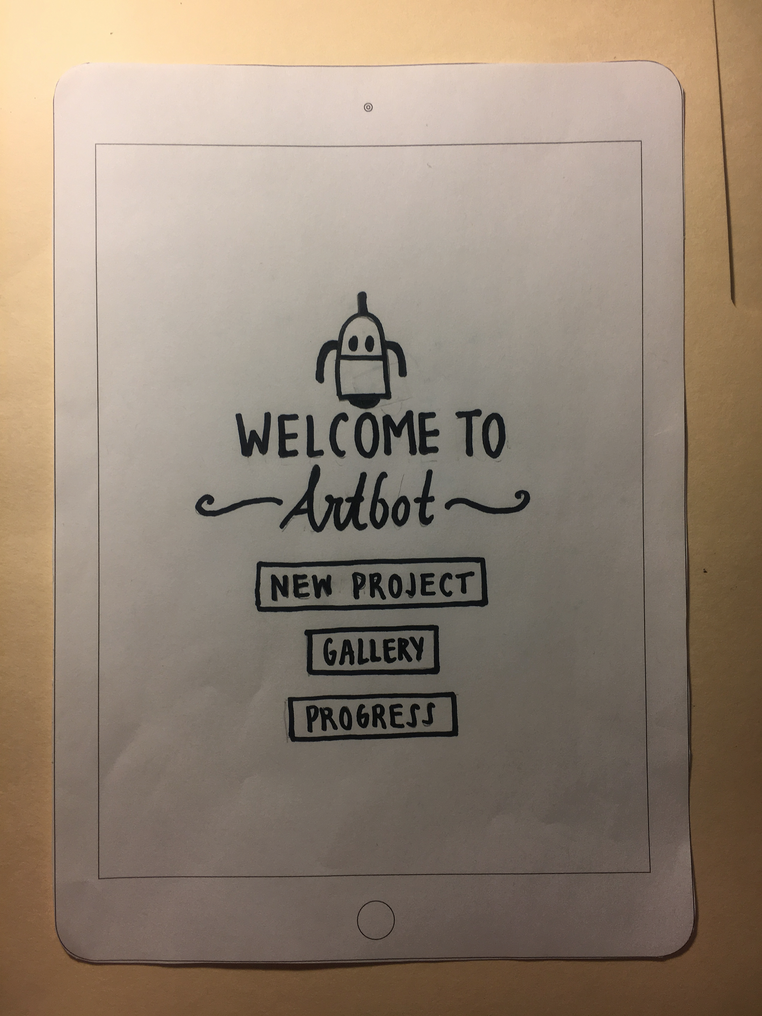
Summary
Users loved the challenge and creativity of Artbot
Change “Creative Wellness” to “Creative Adaptability”
Build on the UI that we have, in terms of clarity and navigation

Slide 22
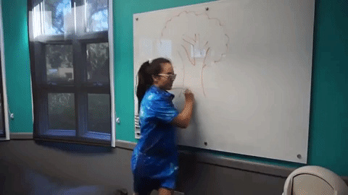
Thanks!
Love, Articulate

